Slide 1
5 Steps To Get Well With Vitality
By Shaqeel Group 5, after I realised that explaining without powerpoint slides is too confusing.

Slide 2
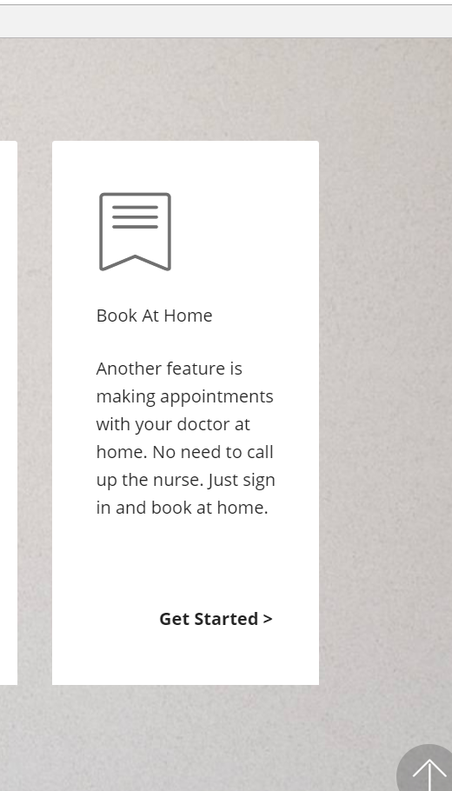
Step Uno: Starting Up
Coming to the website, you shall be greeted by a slideshow with a welcome banner and stories of top news articles that occurred in Singapore.
Scrolling down, you will see 4 cards that gives a brief rundown on what our site does.
Now my part is booking at home, after a survey response had one user stating that he/she would like to book a medical appointment at home without having to physically be there or have to call up the receptionists who occasionally speaks a different language than you.
Therefore, I came up with a way to do just that.

Slide 3
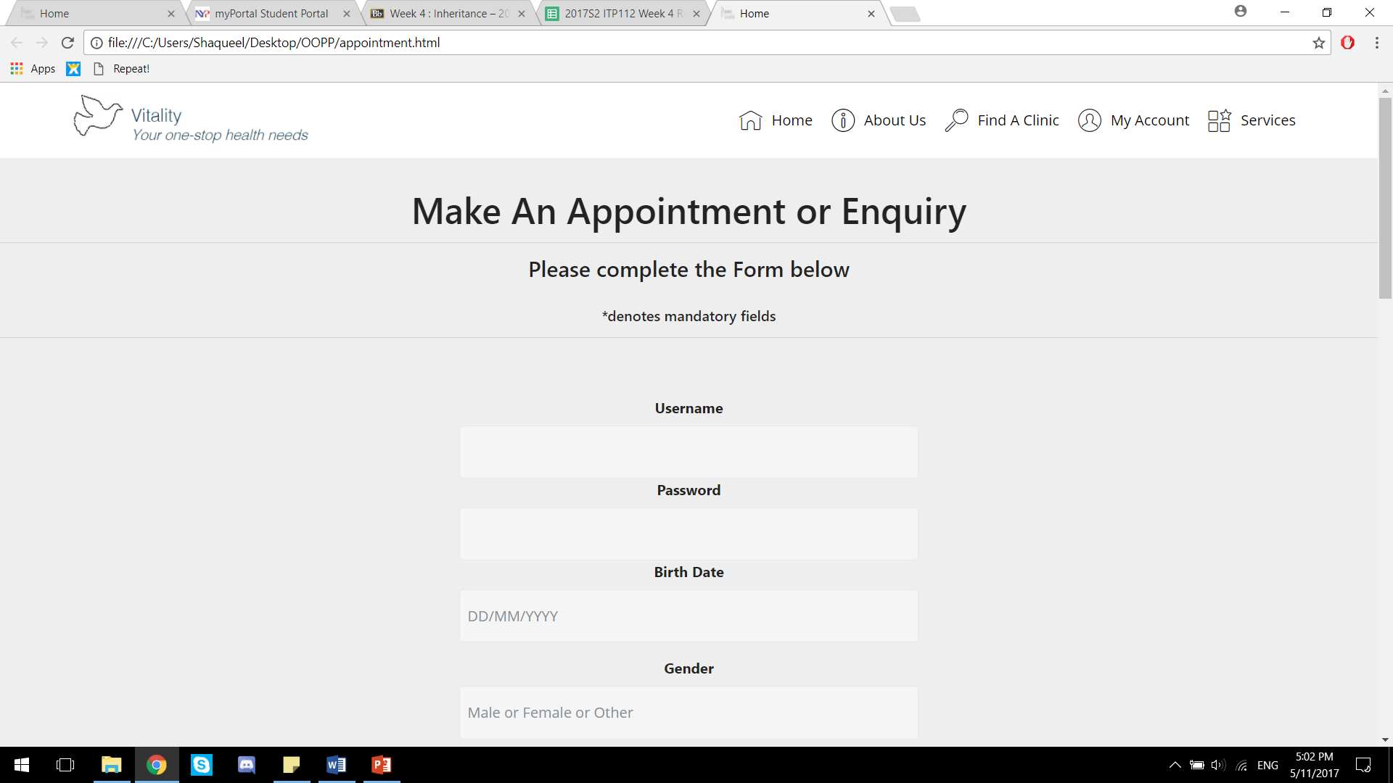
Step 2 : Form Filling
After clicking the link, you be greeted by this page, which prompts you to fill it up. (assuming you already signed up).
After doing so, this information would be sent to your clinic/hospital of choice (For example lets use Yishun Polyclinc)
Which leads us to step 3

Slide 4
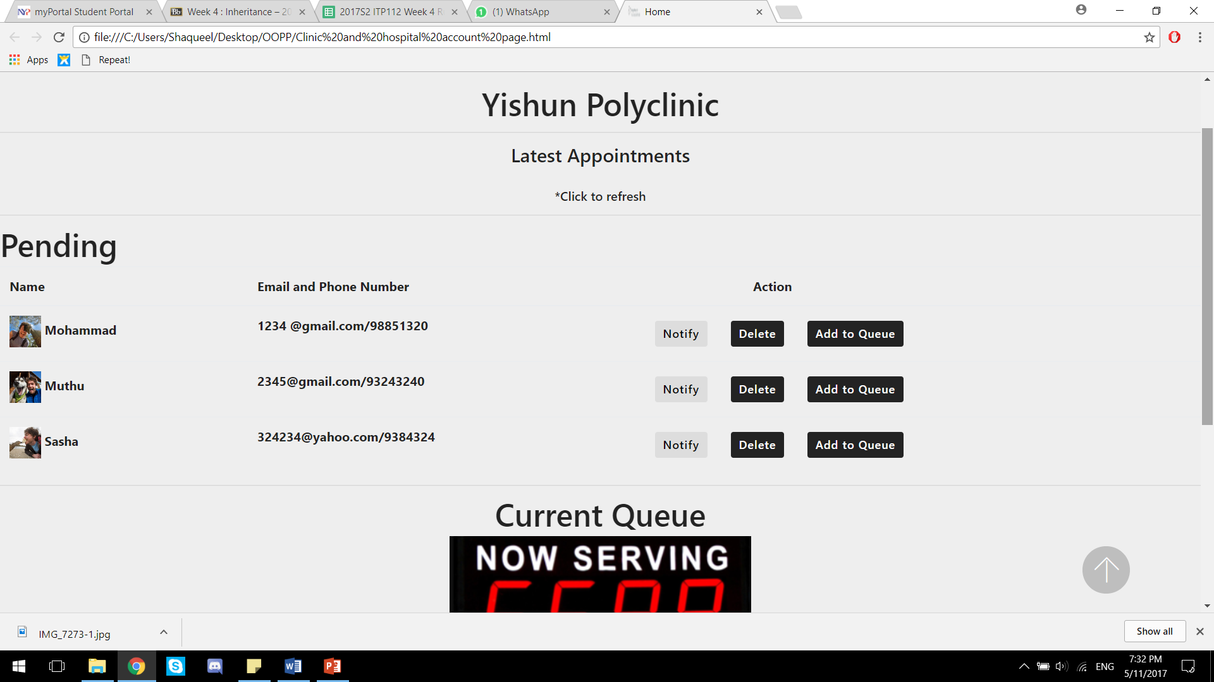
Step Tree : Clinic/Hospital Response
Once that information is sent to the clinic/hospital, these medical centres can use our website to view who is booking their slots and update their queues accordingly. These clinics/hospitals have ‘admin accounts’ on our website which enables them to see their own bookings and choose to accept or decline them.
If they choose to accept the user’s appointment, they will update their Queue tracker with the name and timeslot of said user. And emails/sms the user if he/she managed to get a slot and be given a queue number.

Slide 5
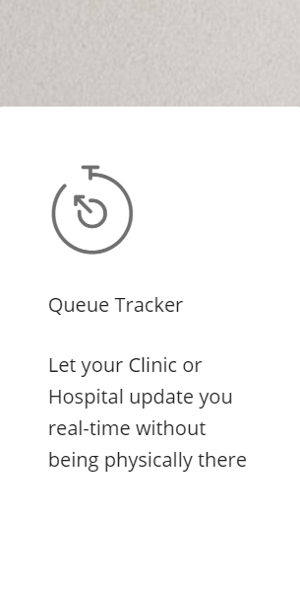
Step For: Patience
If the user did get a text/email from the clinic notifying of their upcoming medical appointment. They can just track the queue using our website’s queue tracker. Which will be further explained later.

Slide 6
Thank You time for demonstration

